Slide 1
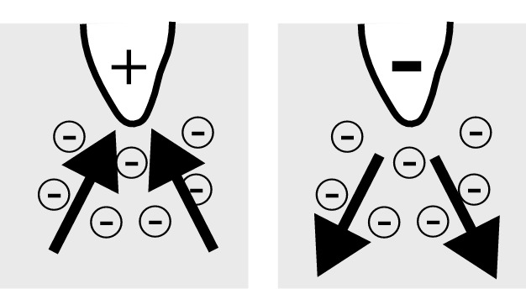
Electrical initiation – push/pull activity

Slide 2
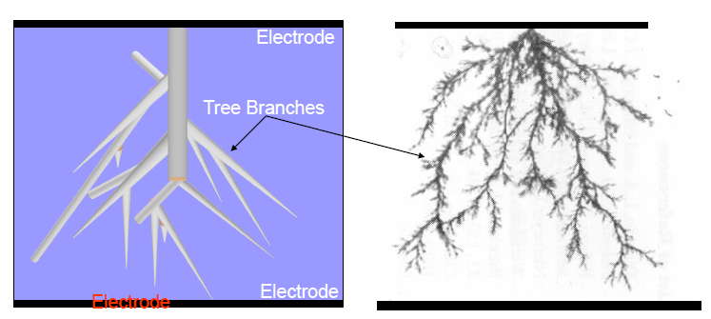
Electrical treeing

Slide 3
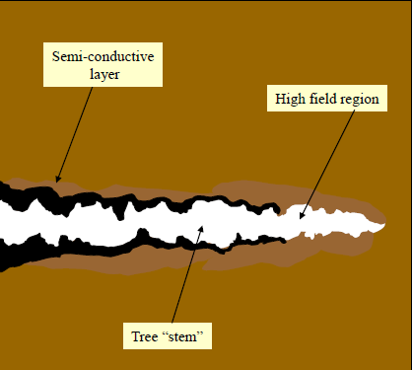
Tree tunnel grows from protrusion

Slide 4
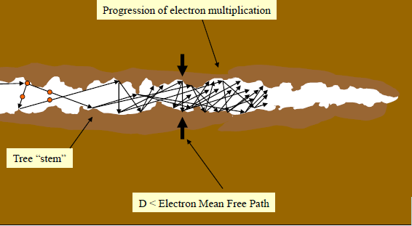
Electrical tree partial discharges

Slide 5
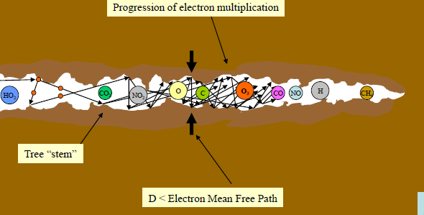
Physiochemical processes in the electrical tree channel

Slide 6
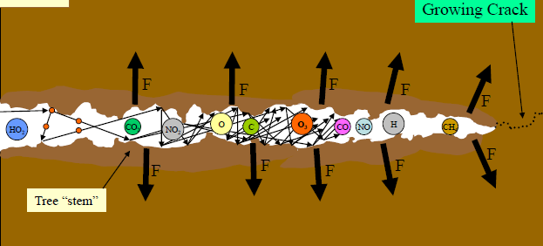
Tree progresses to complete insulation failure

